Slide 1

VIT-AspiraEdge G-47
Pushing Boundaries Unlocking Potential
A launch-ready website for college.

Slide 2
Team-47
WHO ARE WE?
AAYUSH OJHA-23BCE1795
NAIK VEDANT VAIBHAV=23BCE5031
SUJAL KHERA-23BCE5015
TANISH KUMAR-23BCE1787
Albert Einstein
Theoretical Physicist @ EMC2

Slide 3

Mission Statement
Using Tiram.AI, your task is to build a fully functional and launch-ready website for a college. Your website should highlight the institution’s strengths, facilitate student inquiries, and provide essential academic and administrative details in an engaging manner.

Slide 4
HOW TIRAM.AI HELPED US?
💡 #1
💡 #2
💡 #3
Automated Website Development – TIRAM.AI enables users to create fully functional websites using just prompt-based inputs, eliminating the need for extensive coding knowledge.
Rapid Prototyping & Customization – Businesses and individuals can quickly generate website prototypes, tweak layouts, and integrate features in real-time using AI-driven prompt engineering.
Efficiency & Cost Reduction –
By leveraging AI automation, TIRAM.AI significantly reduces development time and costs, making website creation accessible to startups, small businesses, and non-technical users.

Slide 5
🧩 What problem are we solving?
Problem Statement TBG5: Launch-Ready Website for the College
Context: A well-designed college website serves as the face of the institution, providing crucial information for prospective students, parents, faculty, and stakeholders. It should be visually appealing, easy to navigate, and informative while ensuring that all key sections are readily accessible.
Challenge: Using Tiram.AI, your task is to build a fully functional and launch-ready website for a college. Your website should highlight the institution’s strengths, facilitate student inquiries, and provide essential academic and administrative details in an engaging manner.

Slide 6
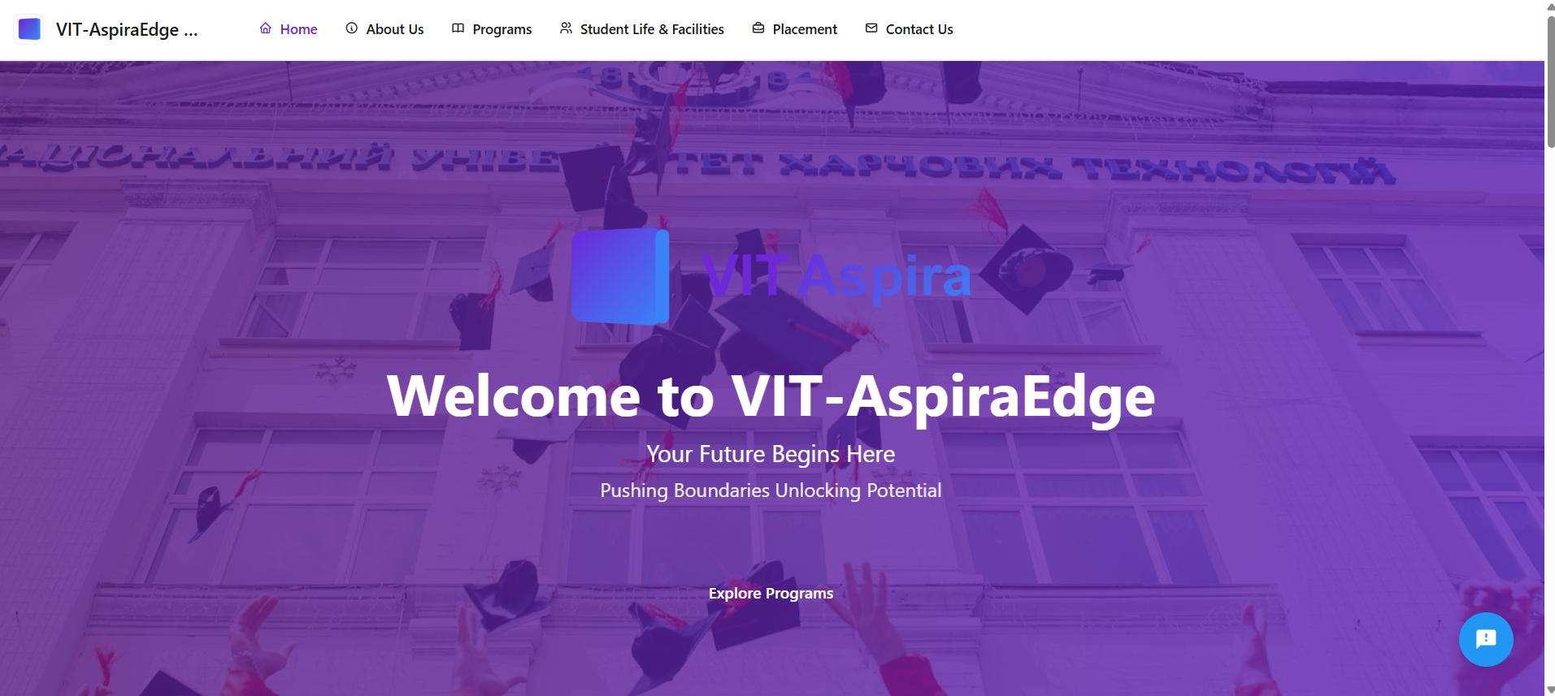
🛠️ What is our solution?
Introduction to VIT-AspiraEdge G-47
KEY SECTIONS OF WEBSITE INCLUDE:
1.)HOME PAGE SECTIONS-
i.)HERO-SECTION

Slide 7
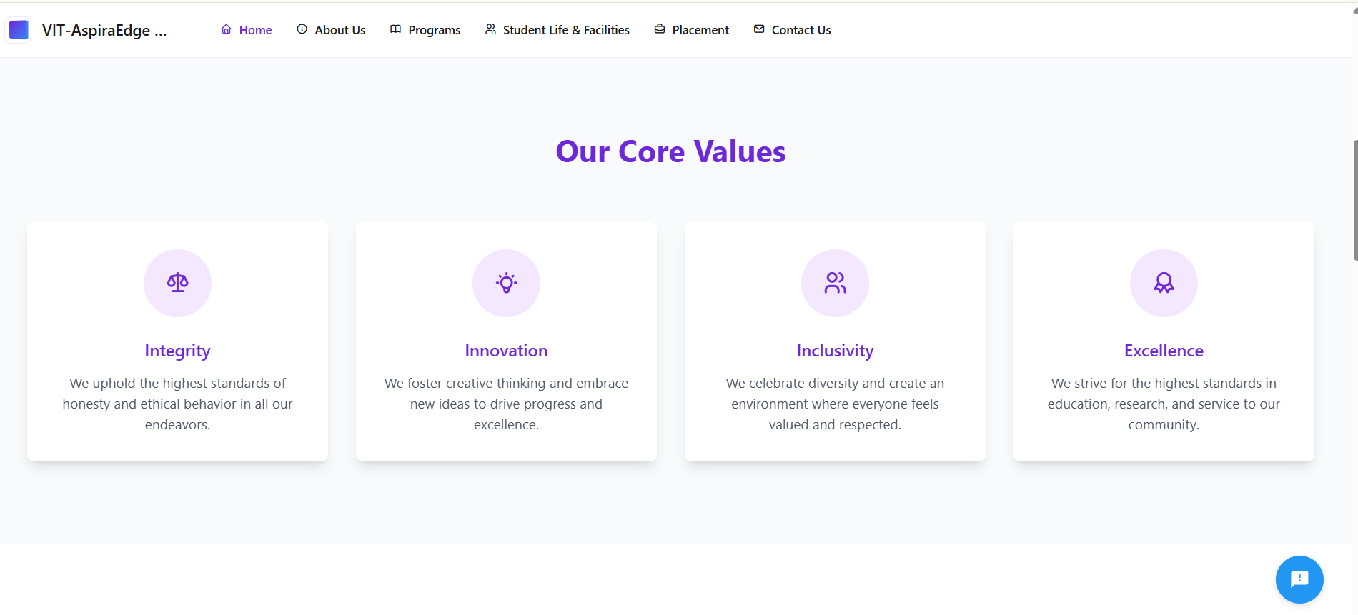
🛠️ What is our solution?

Slide 8
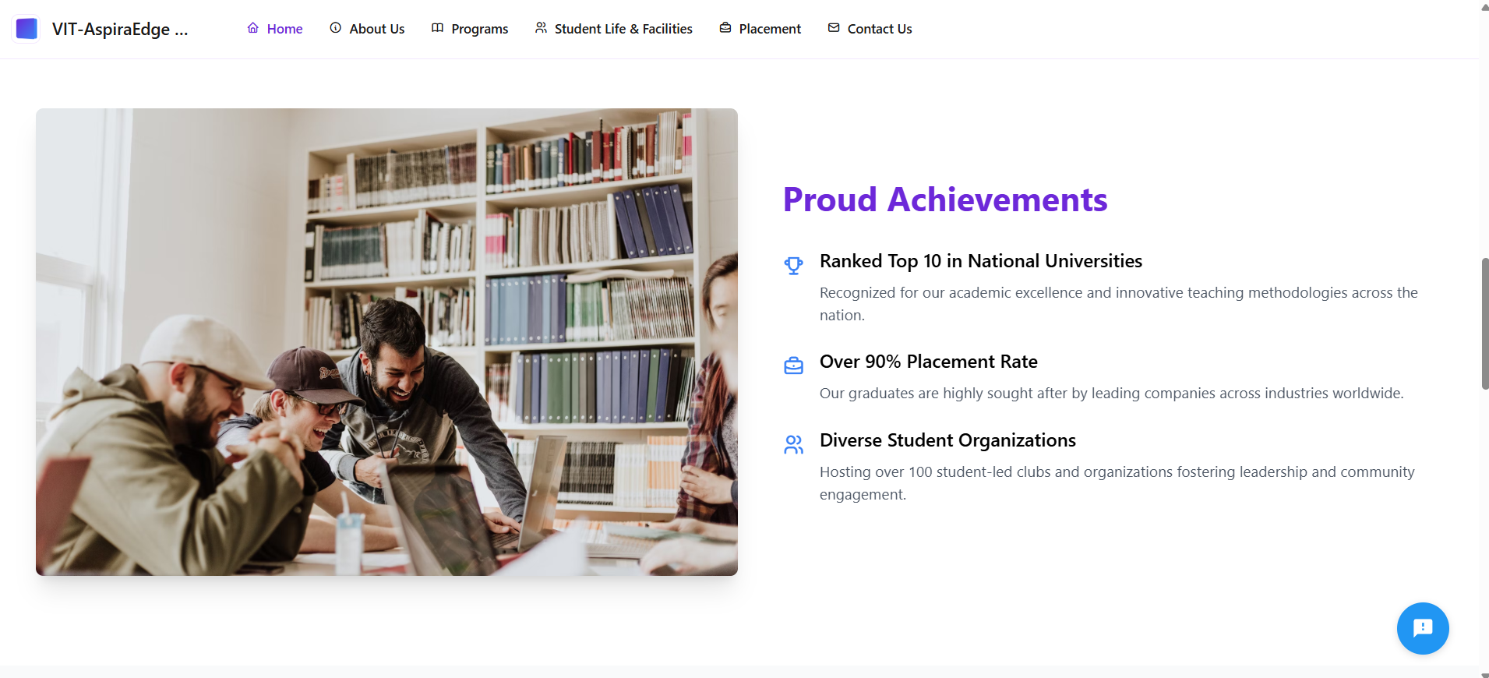

Slide 9
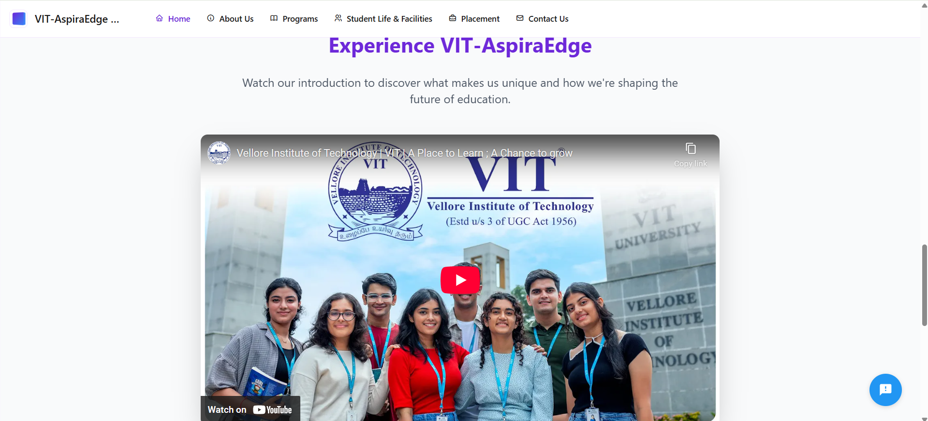

Slide 10
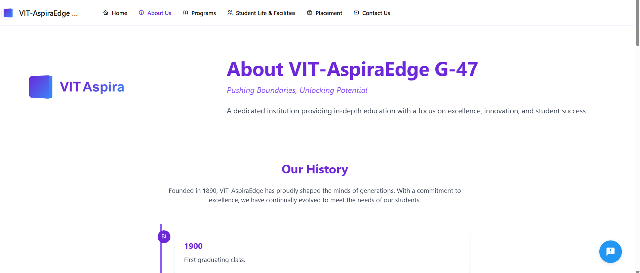
II)ABOUT US SECTIONS:-

Slide 11
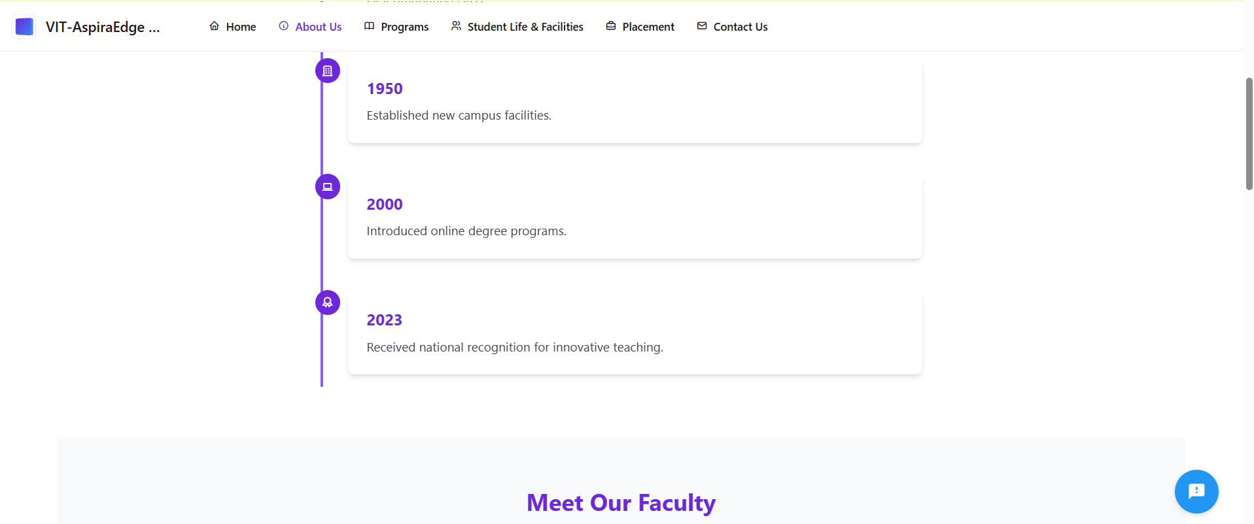
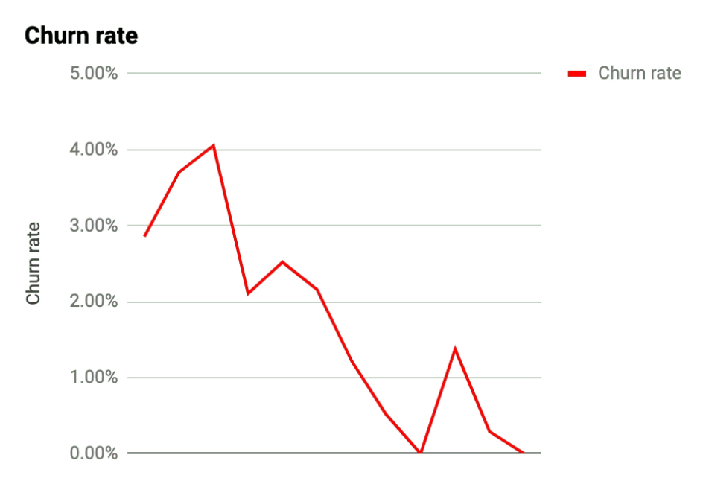
💡 Tip: Trying copying and pasting charts from Google Sheets

Slide 12
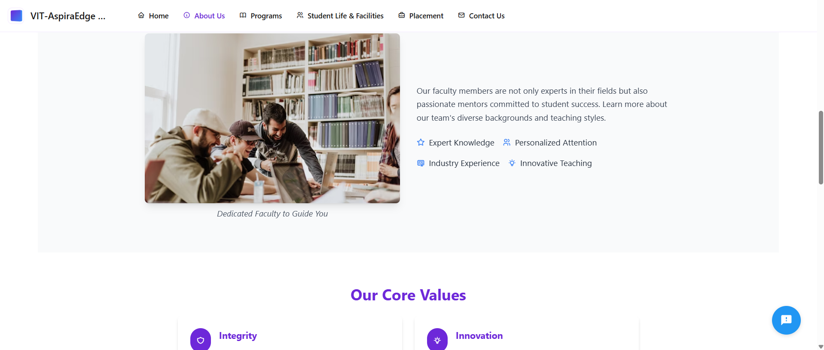

Slide 13
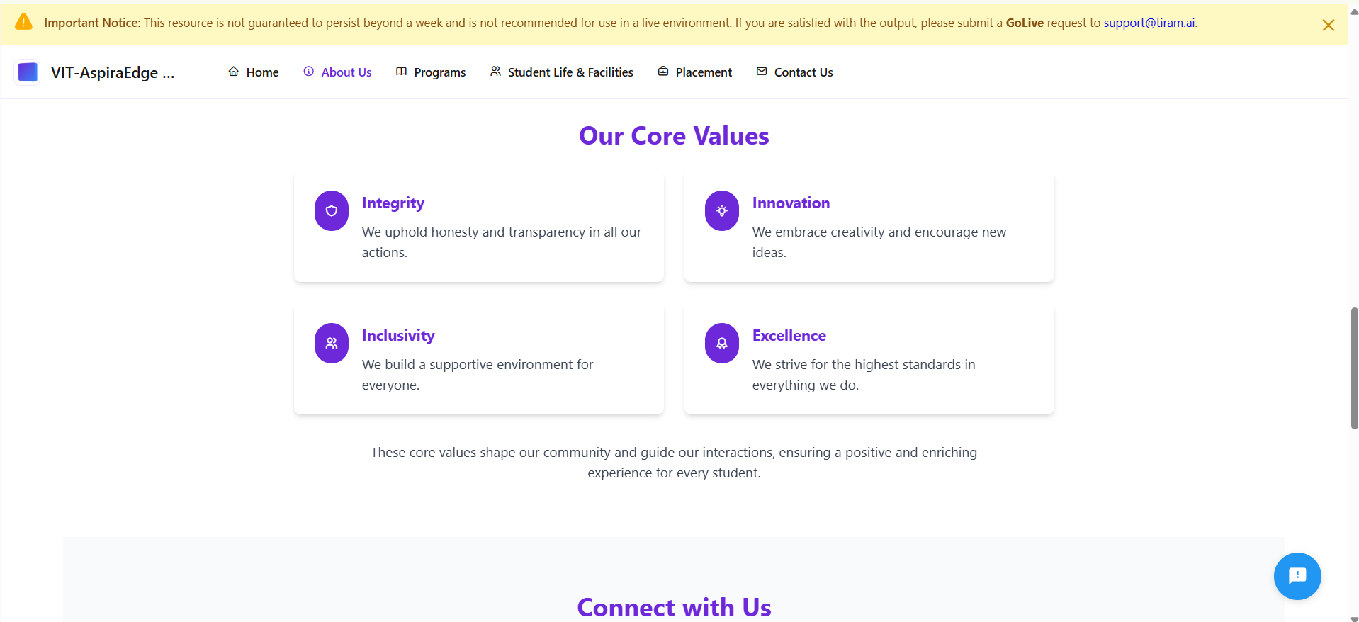

Slide 14
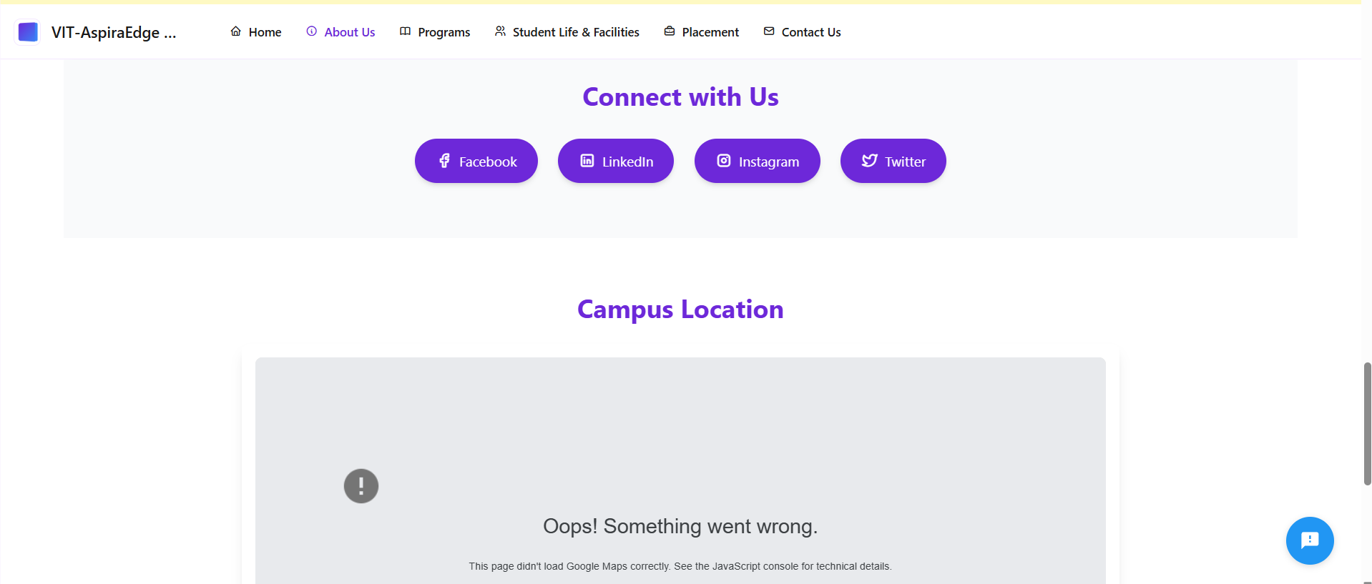

Slide 15
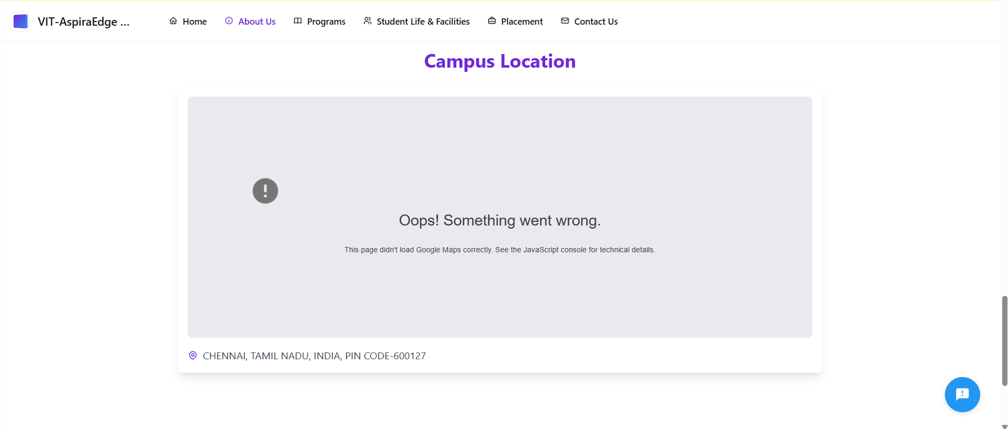

Slide 16
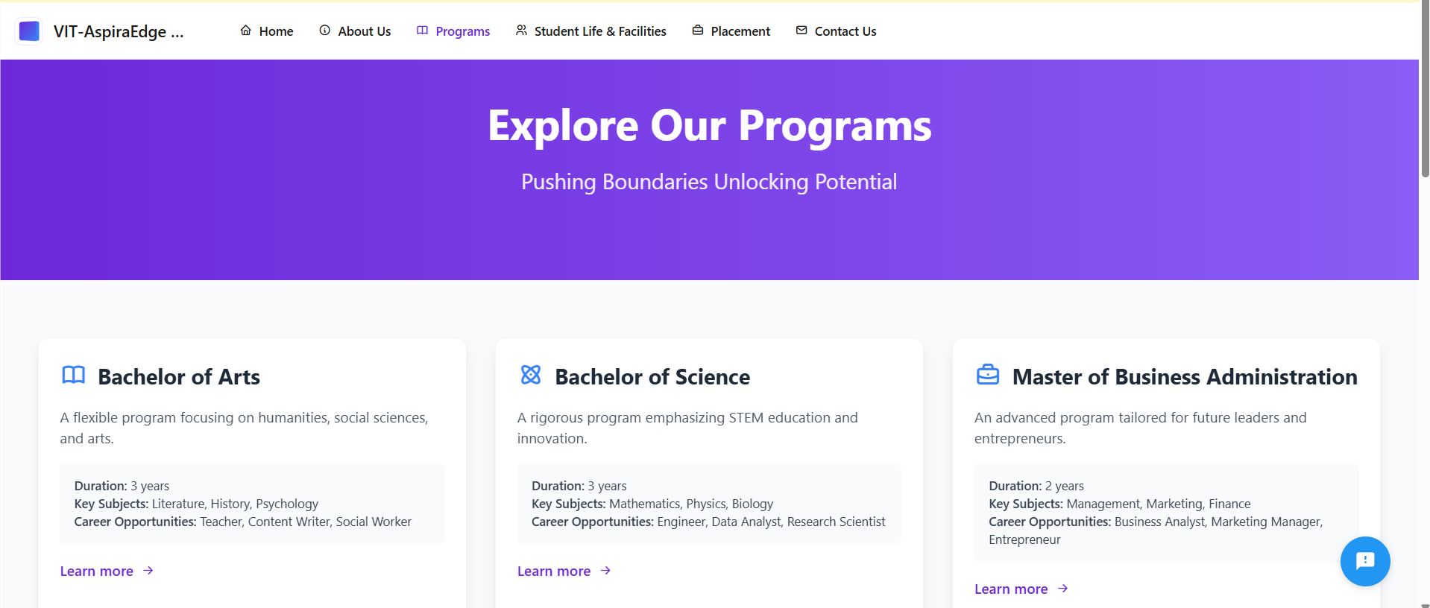

Slide 17
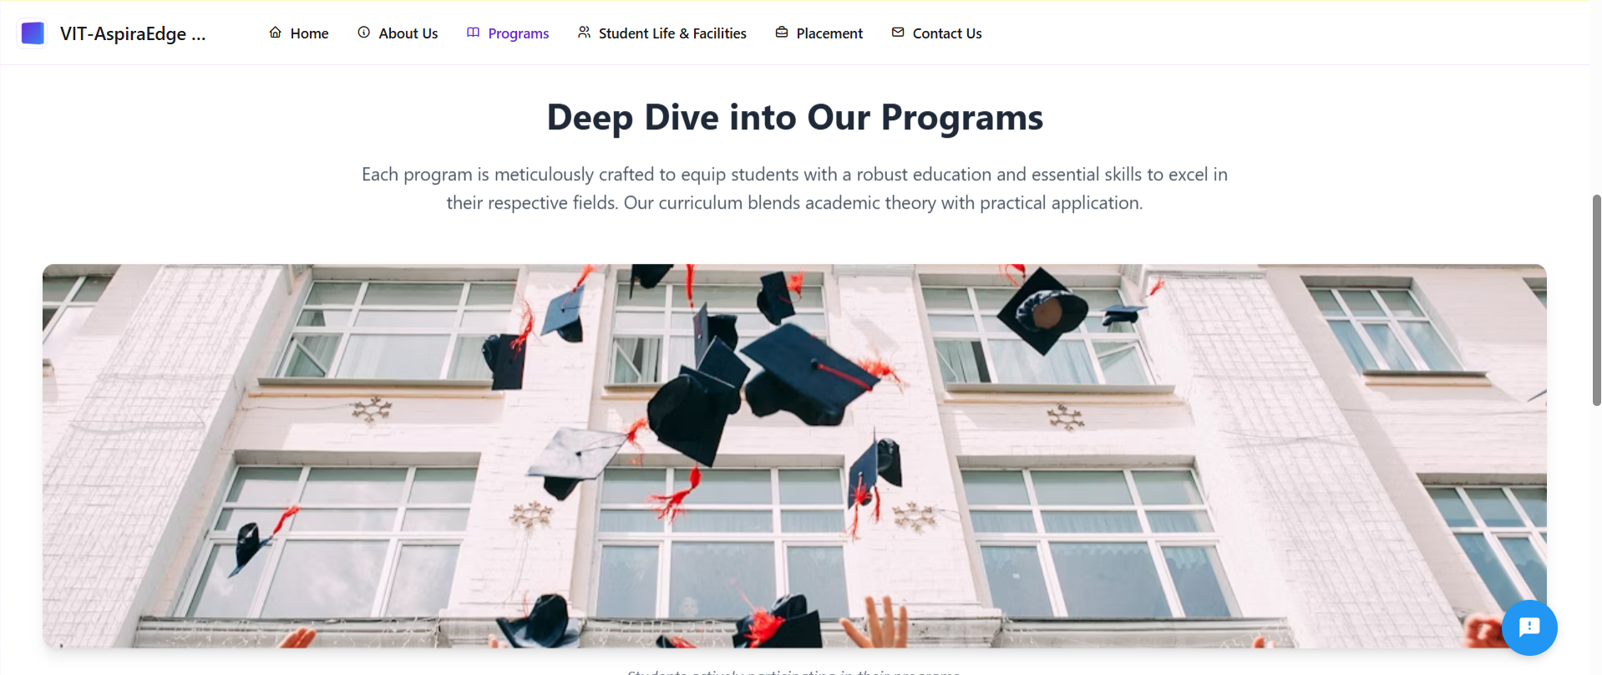

Slide 18
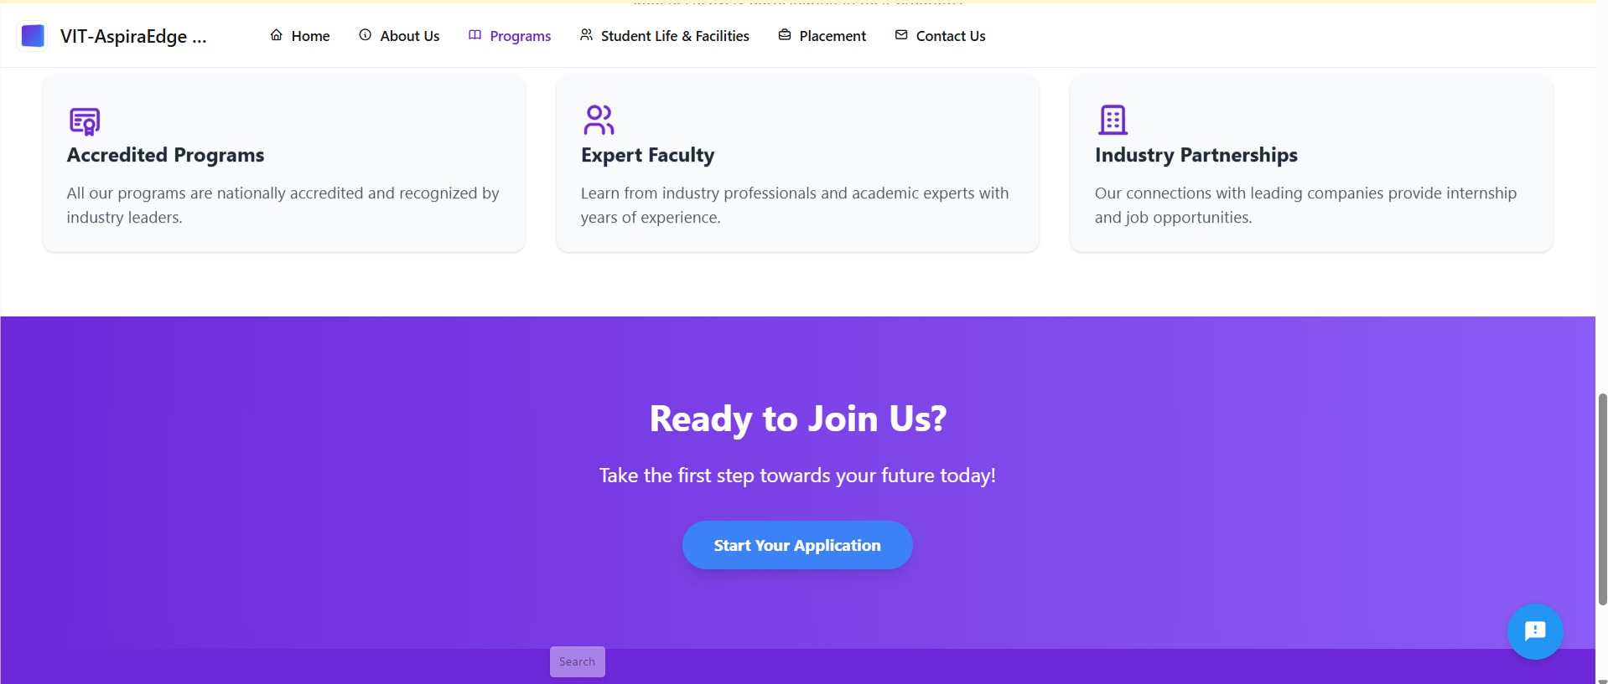

Slide 19
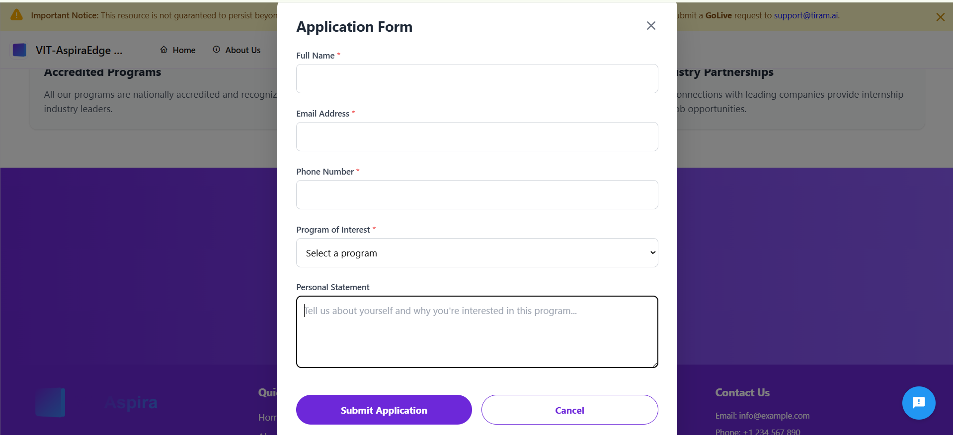

Slide 20
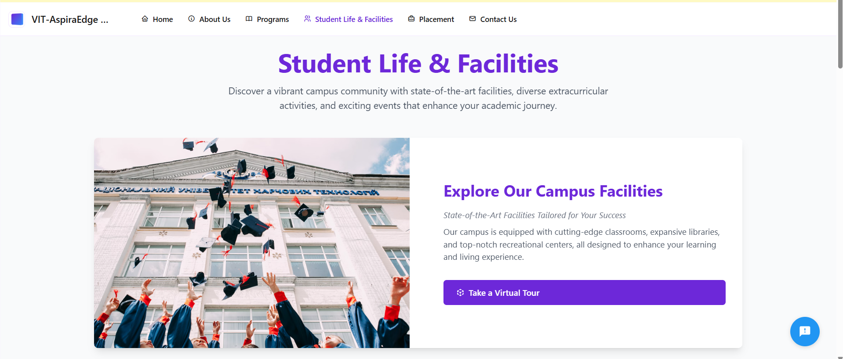

Slide 21
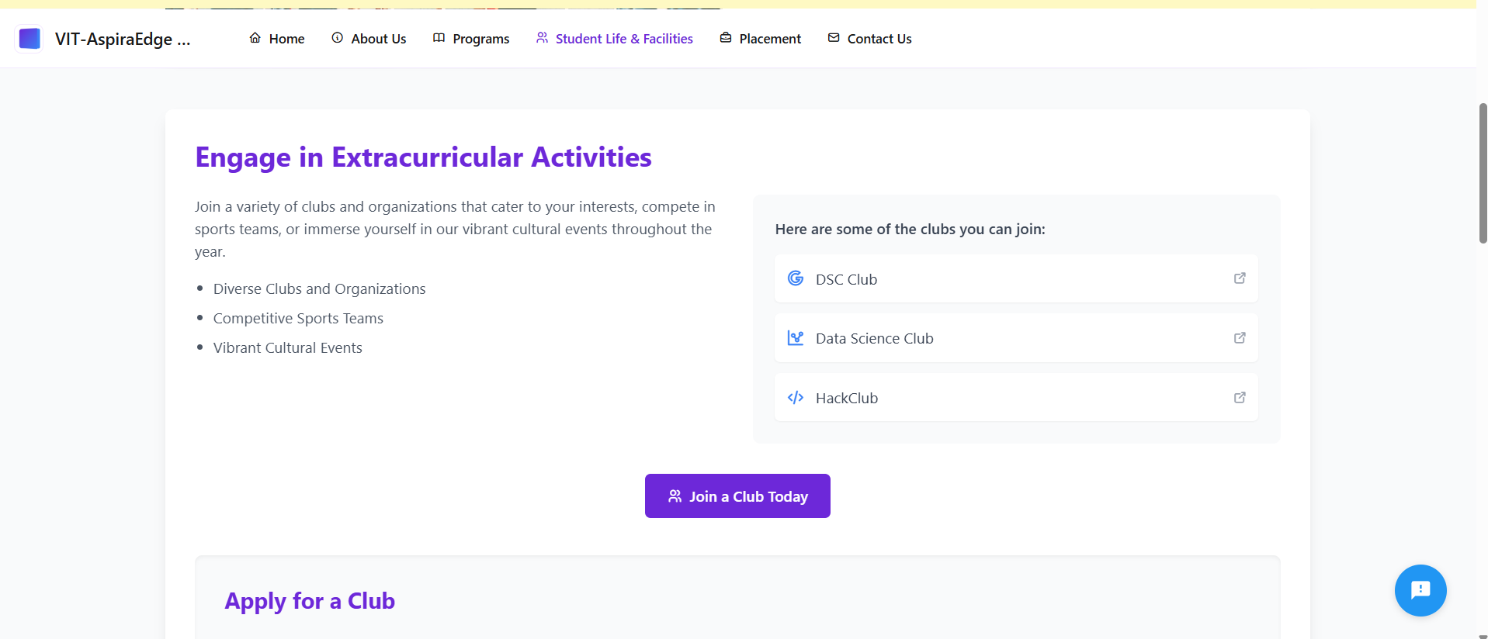

Slide 22
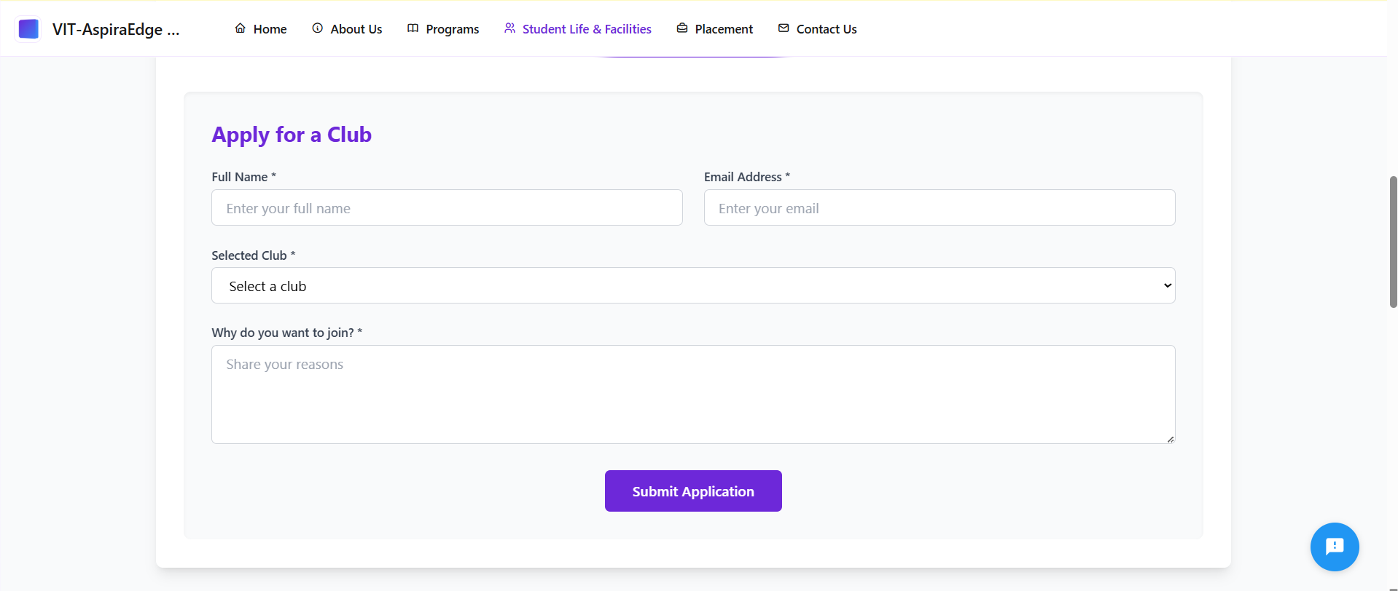

Slide 23
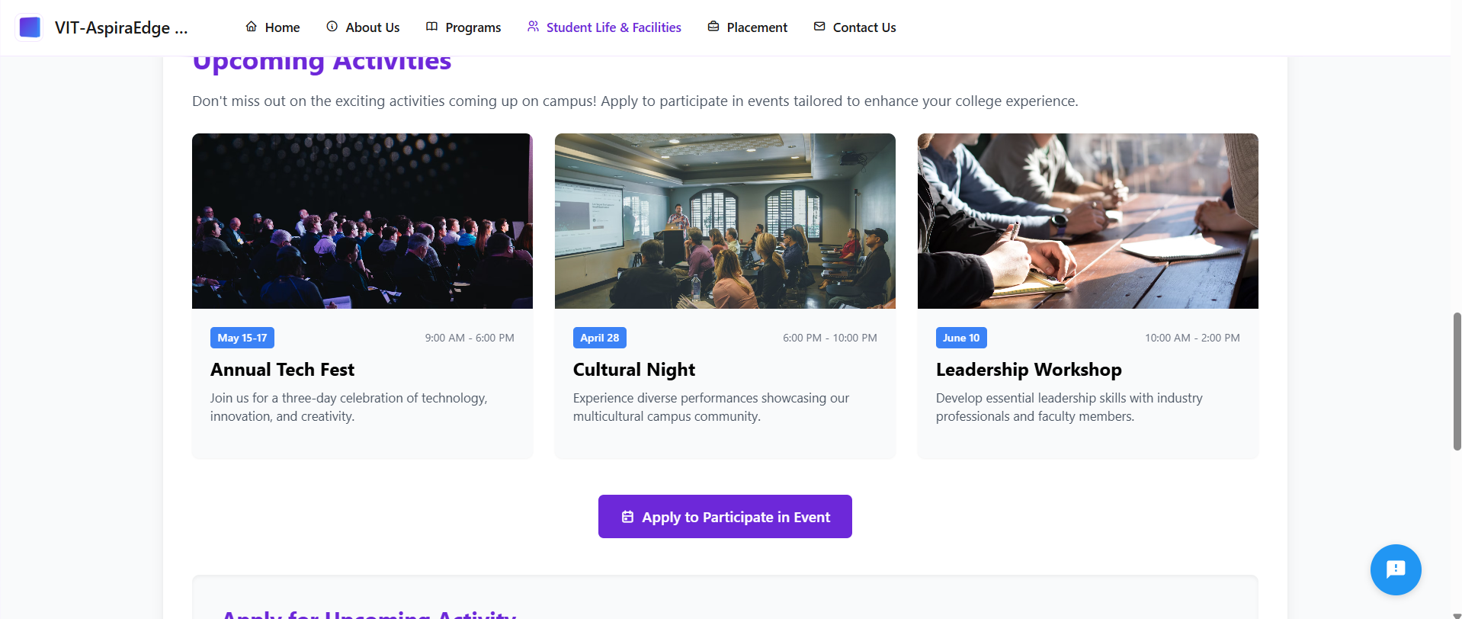

Slide 24
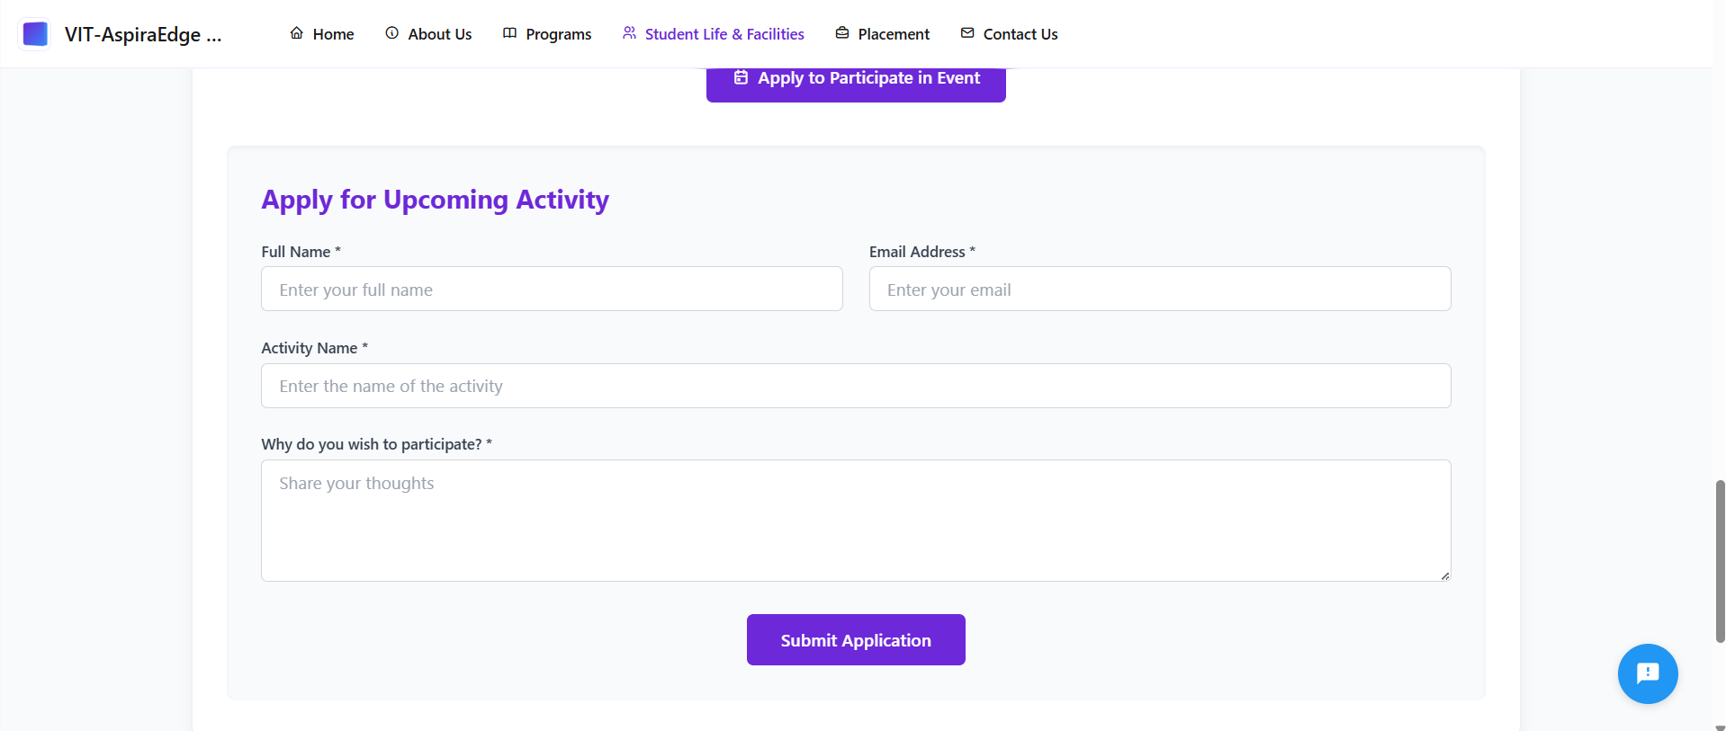

Slide 25
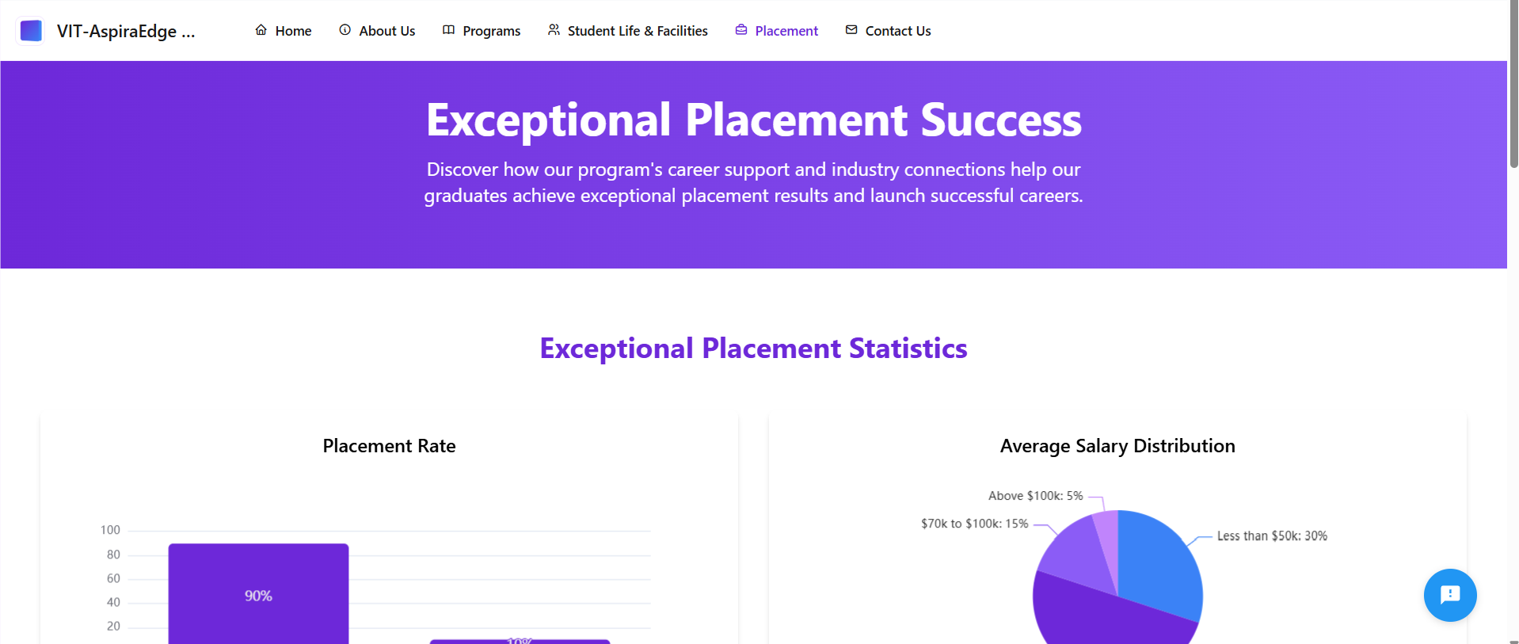

Slide 26
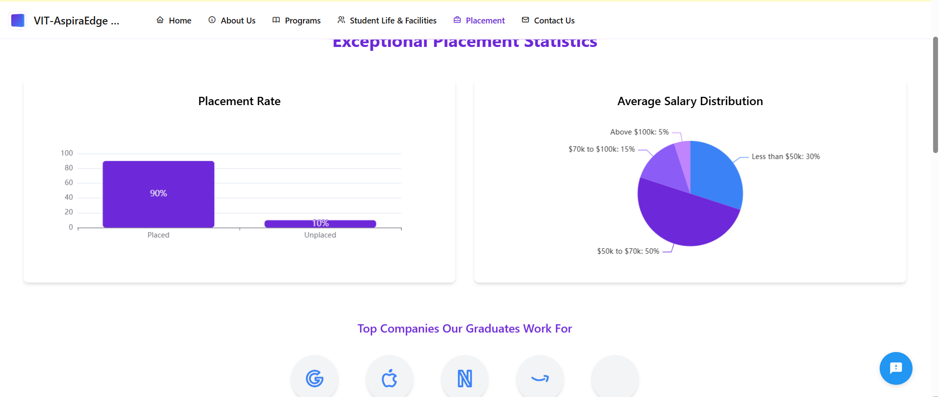

Slide 27
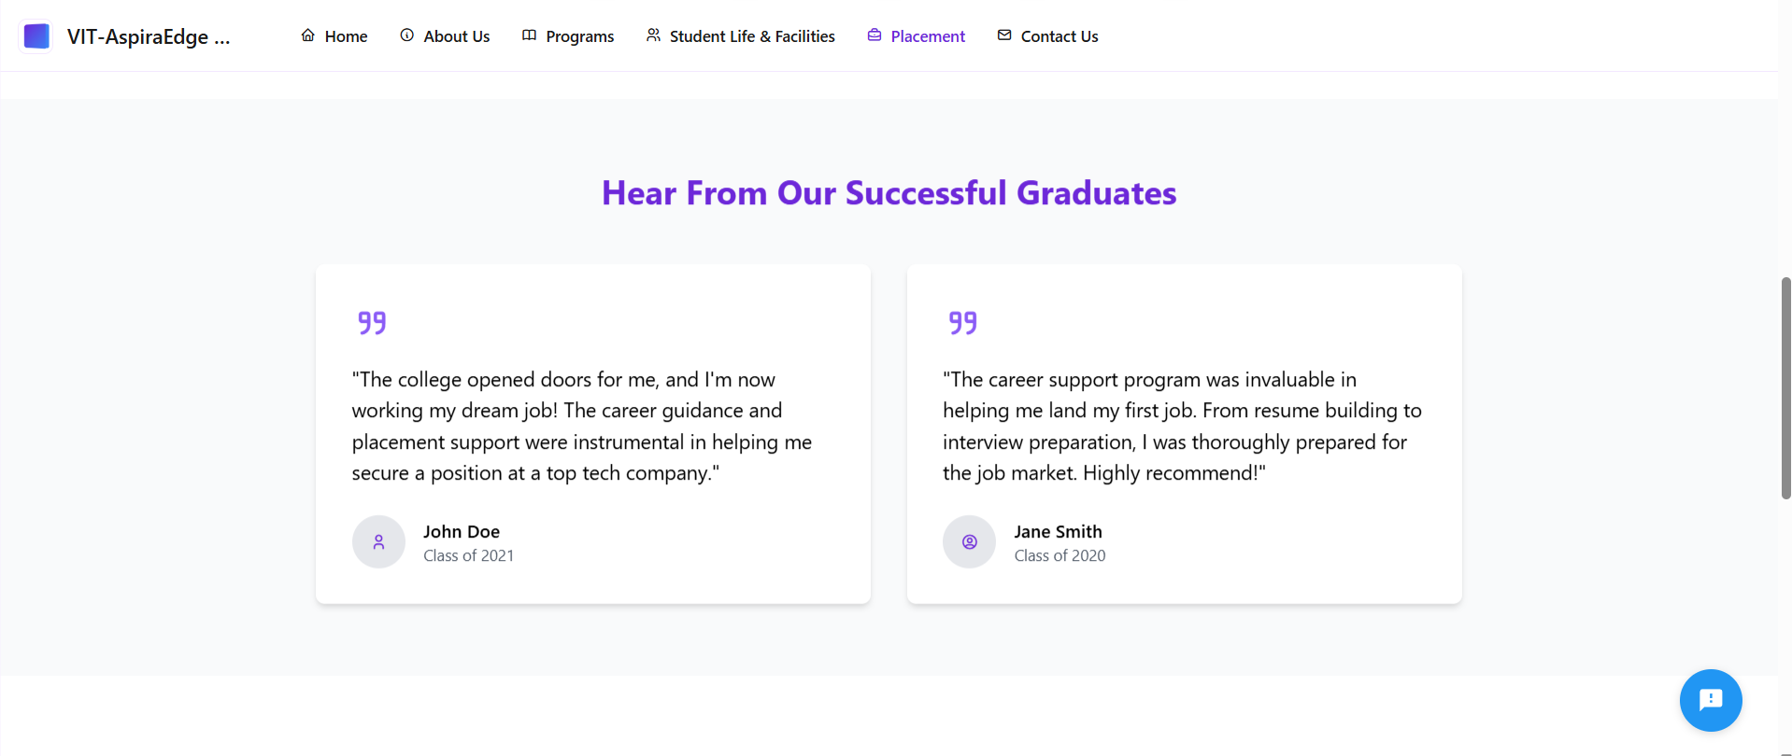

Slide 28
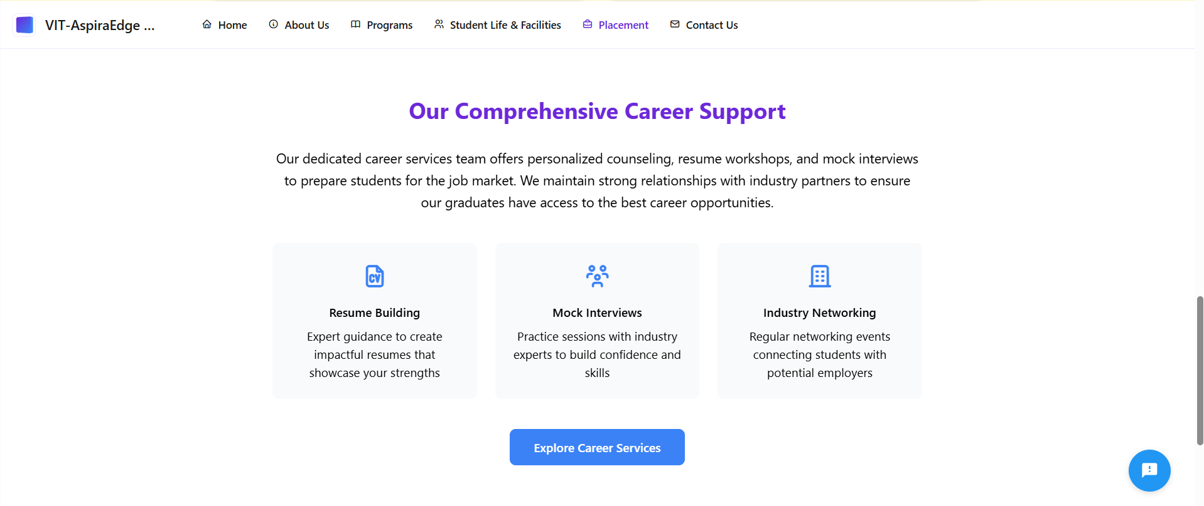

Slide 29
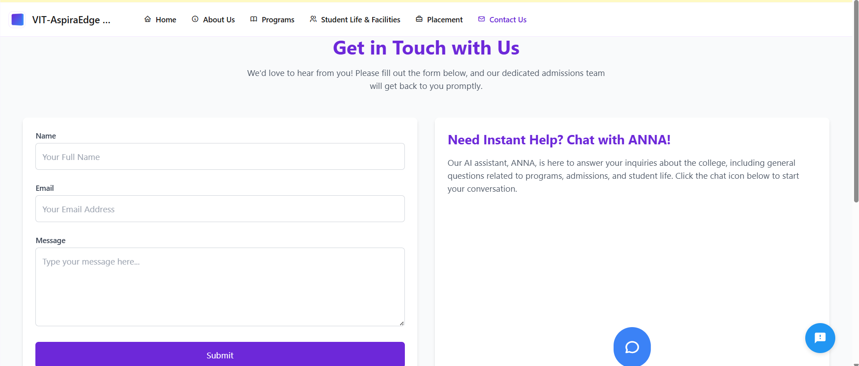

Slide 30
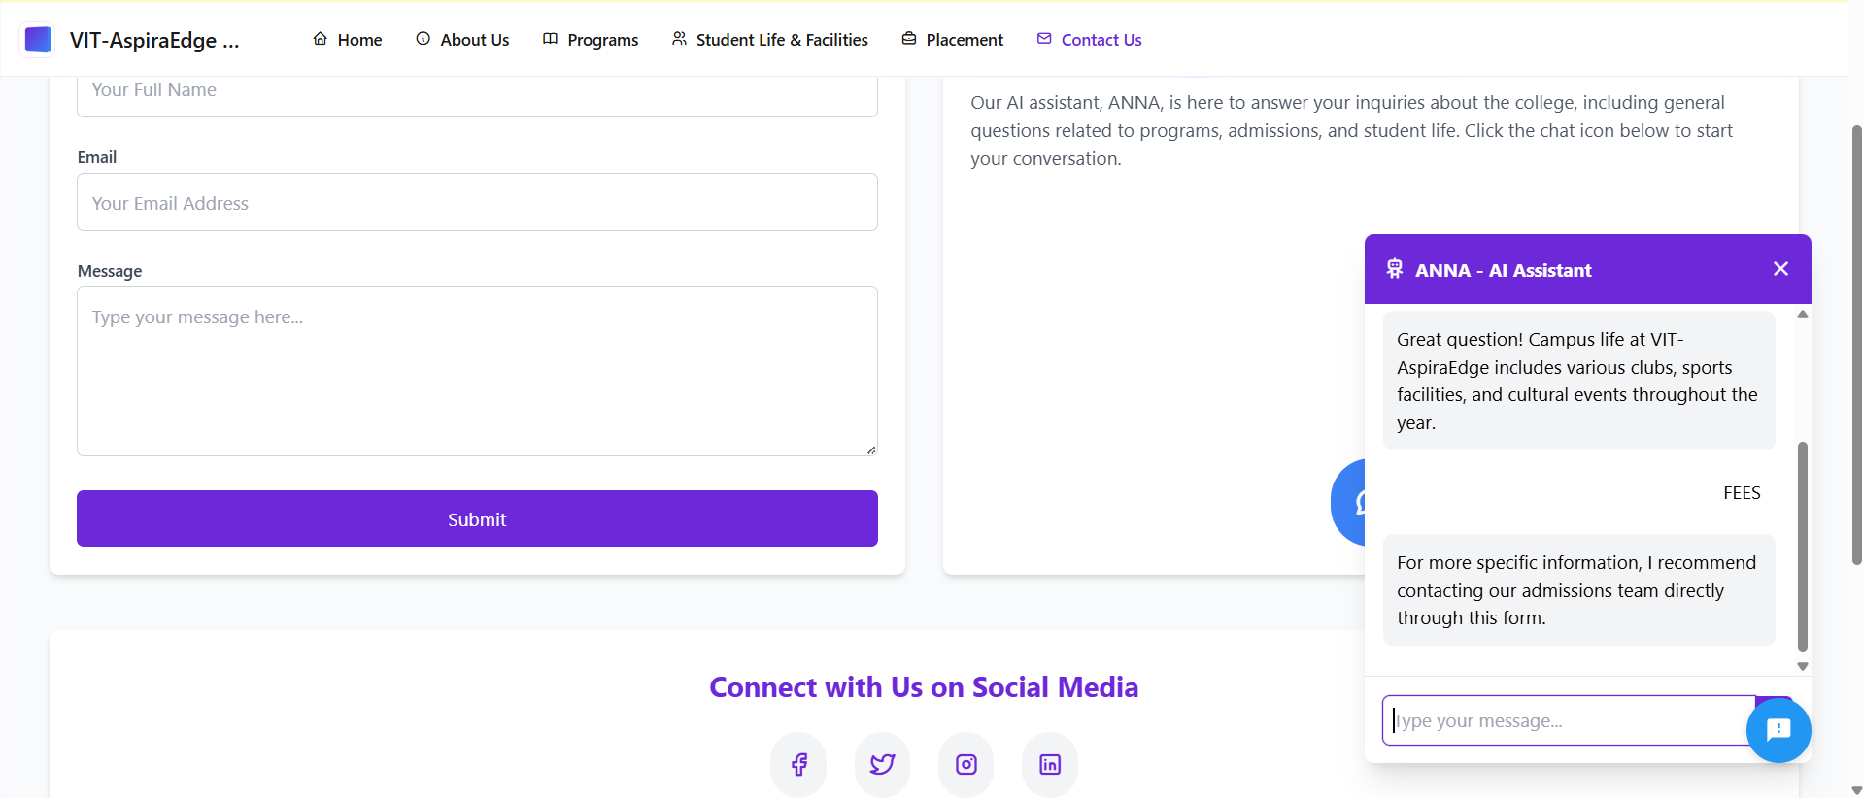

Slide 31
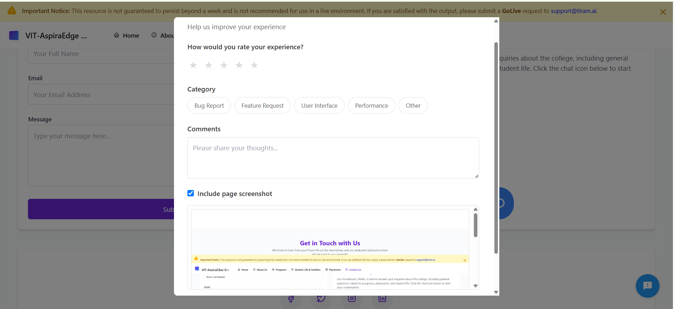

Slide 32
Challenges Faced during the Hack-A-Thon
1. Time Pressure & Constraints
Squeezed time to create a complete, ready prototype.
Keeping scope creep away and not introducing unnecessary complexity.
2. Fatigue & Burnout
Mental fatigue and sleep deprivation may reduce productivity.
The struggle to stay focused and charged throughout the event.
3. Team Coordination & Communication
Coordinating ideas and dividing responsibilities effectively under deadline pressure.
Conflicts arising due to stress or varying levels of skill.

